Slide 1

Market Research
Submitted By
Bandana Das
Faculty
B.Voc(TTM)

Slide 2
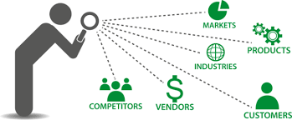
What is Market Research
Identifying the customer needs especially in a tourism industry which has very high service base content is very important. This is possible only through systematic market research and analysis.Market research can be defined as the “systematic collection of information relating to supply and demand for a product or a proposed product in such a way that the information may be used by the organization to formulate informed decisions about its policies and its objectives.”

Slide 3
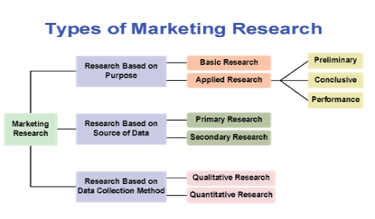

Slide 4
Techniques of Market Research
Market research is a continuous process. Among the variety of method used, some seem to be widely resorted to because of their advantages over others. Research techniques can be grouped as:
Desk Research: It includes the collection and analysis of all available data, statistics and published informationon tourist trends and market.
Field Research: It is the research work carried out in the tourist- generating markets itself. The special investigations in the field are to be carried out with a view to know more details of the market situation.Field research includes methods among which the most common are the sample surveys and the motivation research.

Slide 5
Techniques of Market Research
Sample Survey: It could be defined as the study of a given population through only a part. Sampling techniques consist of personal interviews of tourists, travel agents, carriers and hotel managers etc. by way of personal interviews with the help of prepared questionnaires, by mailing questionnaires or through telephone contacts.
Motivation Research: It is to describe and forecast the motives of the population under investigation by use of techniques originally used in psychology. It is the investigation into the motives behind travel. It provides answers to very important questions. The most important techniques used in
Motivation research is the depth interview method. The questionnaire to be used for this method needs to be carefully designed. Other techniques used are the projective methods like word association tests, sentence completion test and pictorial tests etc. and observations. That means have been devised to record the reactions of a person and to understand his motives.

Slide 6
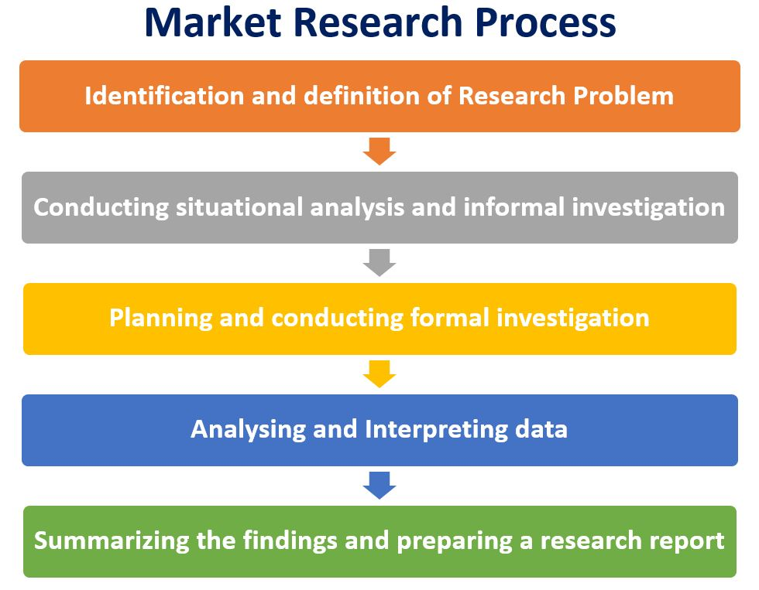
Market Research Process

Slide 7


